Slide 1
DirectWrite
SGA Programming

Slide 2
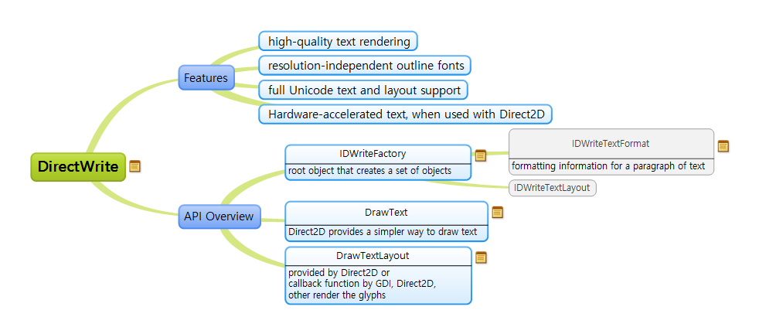
Overview

Slide 3
Features
high-quality text rendering
resolution-independent outline fonts
full Unicode text and layout support
Hardware-accelerated text, when used with Direct2D

Slide 4
API Overview
IDWriteFactory
root object that creates a set of objects
  IDWriteTextFormat
  formatting information for a paragraph of text
  IDWriteTextLayout
DrawText
Direct2D provides a simpler way to draw text
DrawTextLayout
provided by Direct2D or
callback function by GDI, Direct2D,
other render the glyphs

